Slide 1



UNIVERSAL SERIAL BUS

Slide 2
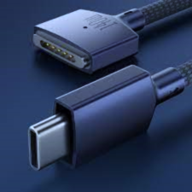


GROUP MEMBERS :
TOPIC :
Universal Serial Bus (USB)
NAME: Sushant Kumar
ROLL NO. : B43
SECTION : K23SA
REG. NO. : 12311087
NAME: Arjun Kumar
ROLL NO. : B72
SECTION : K23SA
REG. NO. : 12313473
WELCOME

Slide 3

CONTENT
Introduction of USB
Evolution of USB
Types of USB Ports & their Common uses
Versions of USB
Color Coding of USB
How USB works & Data transfer rate
USB in computing
USB In Mobile Devices
USB in Peripheral Devices
Advantages of USB
USB Security
USB in everyday life
Conclusion
Questions

Slide 4


Introduction of USB
What is USB ?
USB stands for Universal Serial Bus.
Allow users to connect a wide variety of peripheral to a computer.
It is used to transfer data from one device to another.
Following are the examples of USB devices:
Mouse
Keyboard
Printer
Scanner
Webcams
Microphones
Storage devices like pendrives

Slide 5



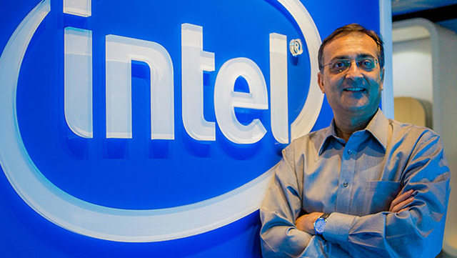




Evolution of USB
Ajay V. Bhatt is an Indian-born American computer architect who defined and developed Universal Serial Bus in 1995.
Led a team of 7 Companies to develop USB standard
Ajay V. Bhatt

Slide 6

Versions of USB
USB TYPE | SPEED TITLE | MAX. BANDWIDTH | REALEASE DATE
USB 1.0 | Low Speed | 1.5 Mbps | January, 1996
USB 1.1 | Full Speed | 12 Mbps | August, 1998
USB 2.0 | High Speed | 480 Mbps | April, 2000
USB 3.0 | Super Speed | 5 Gbps | November, 2008
USB 3.1 | Super Speed + | 10 Gbps | July, 2013
USB 3.2 | SS20 | 20 Gbps | August, 2017
USB 4 | SS40 | 40 Gbps | 2019
USB 4 version 2 | SS80 | 8 0 Gbps | 2022
SS Represents “ Super Speed ”

Slide 7
Types of USB Cables
USB TYPE | NUMBER OF PINS | VERSION SUPORTED | MAXIMUM SPEEDS | USED IN
Type A | 4 | 2.0, 3.0, 3.1, 3.2 | 480 Mbps, 5 Gbps, 10 Gbps | Computers, tablets, television sets, flash drives, keyboards
Type B | 4 | 2.0, 3.0, 3.1 | 480 Mbps, 5 Gbps | Printers, Scanners
Type C | 24 | 2.0, 3.0, 3.1, 3.2 | 480 Mbps, 5 Gbps, 10 Gbps | Smartphones, headphones
Mini A&B | 5 | 2.0 | 480 Mbps | Digital camera, computer peripherals
Micro A&B | 5 | 2.0 | 480 Mbps | Smartphones, computer peripherals, video game controllers
Lightening Cables | 8 | 3.0 | 480 Mbps, 5 Gbps | Apple’s devices

Slide 8

Types of USB Cables & Their Uses
Type A
Type B
Type C
Number of Pins : 4
Versions Supported : 2.0, 3.0, 3.1, 3.2
Maximum Speed : 480 Mbps, 5 Gbps, 10 Gbps
Used in : Computers, tablets, television sets, flash drives, keyboards
Number of Pins : 4
Versions Supported : 2.0, 3.0, 3.1
Maximum Speed : 480 Mbps, 5 Gbps
Used in : Printers and Scanners
Number of Pins : 24
Versions Supported : 2.0, 3.0, 3.1, 3.2
Maximum Speed : 480 Mbps, 5 Gbps, 10 Gbps
Used in : Smartphones, Headphones

Slide 9
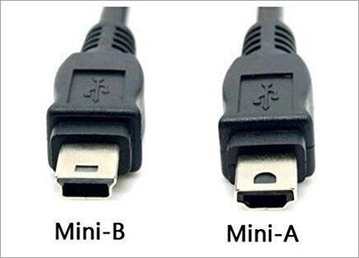
Types of USB Cables & Their Uses
Mini A&B
Micro A&B
Lightening Cables
Number of Pins : 5
Versions Supported : 2.0
Maximum Speed : 480 Mbps
Used in : Digital camera, computer peripherals
Number of Pins : 5
Versions Supported : 2.0
Maximum Speed : 480 Mbps
Used in : Smartphones, computer peripherals, video game controllers
Number of Pins : 8
Versions Supported : 3.0
Maximum Speed : 480 Mbps, 5 Gbps
Used in : Apple’s devices

Slide 10

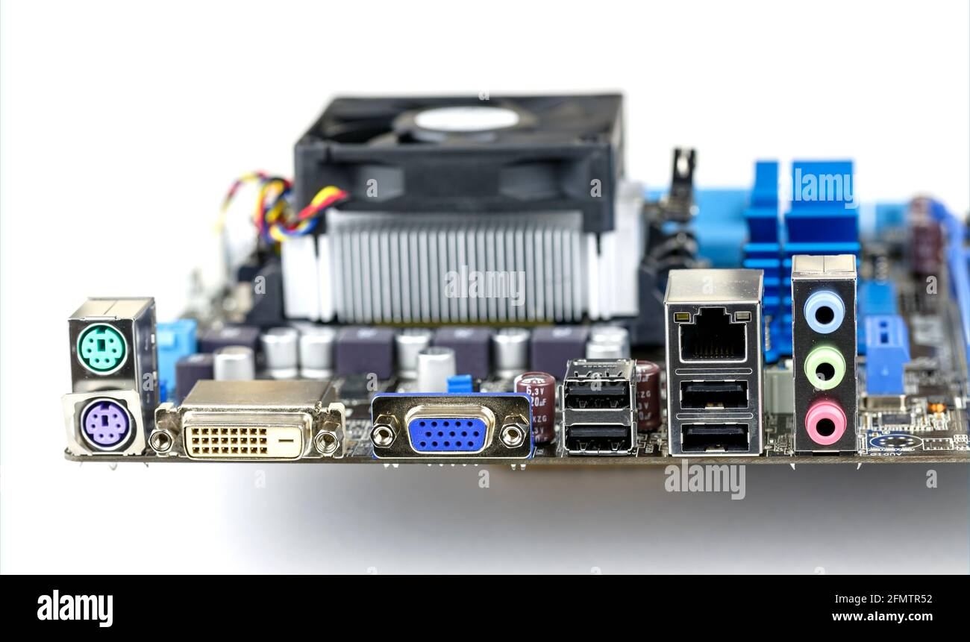
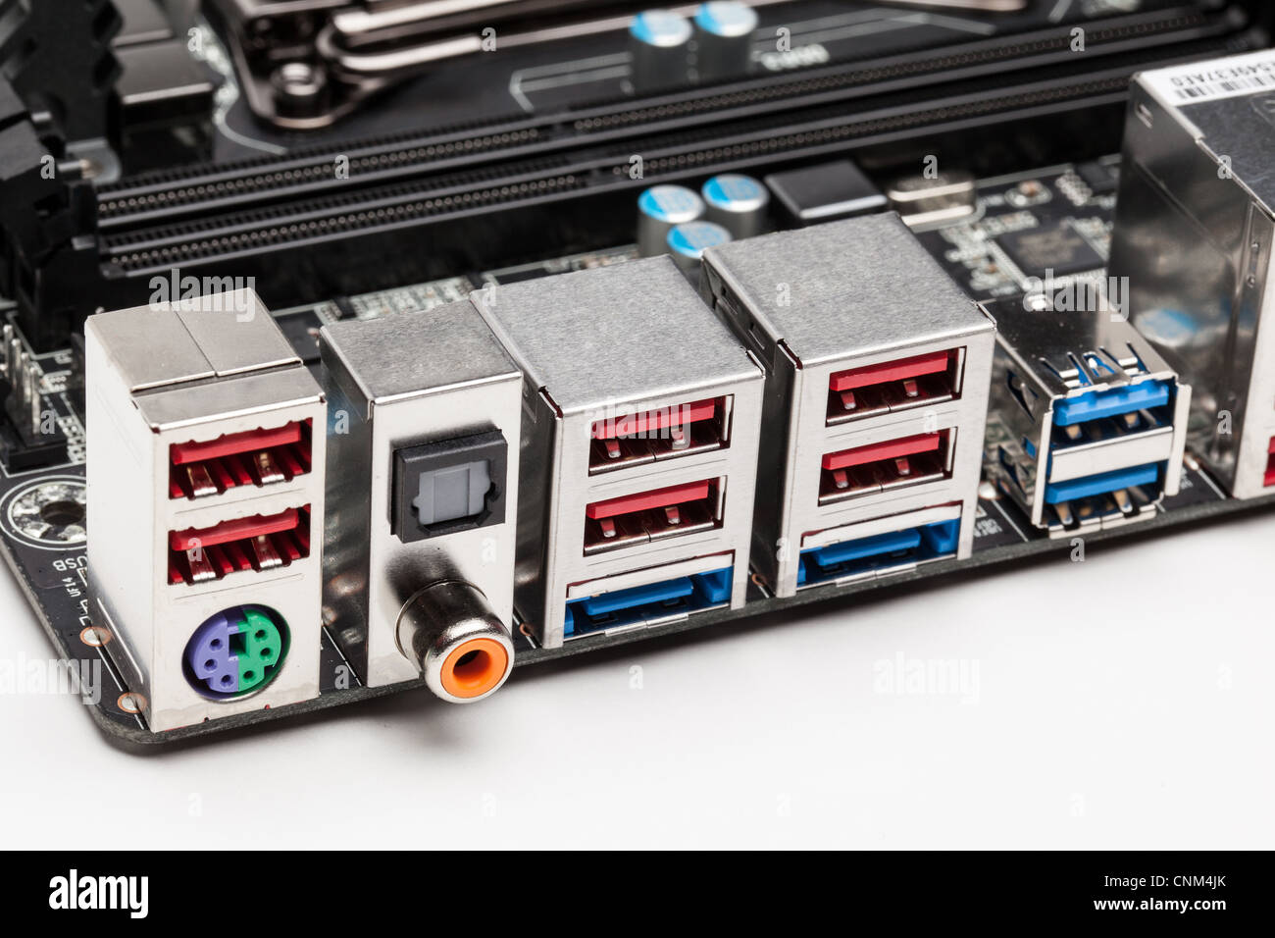
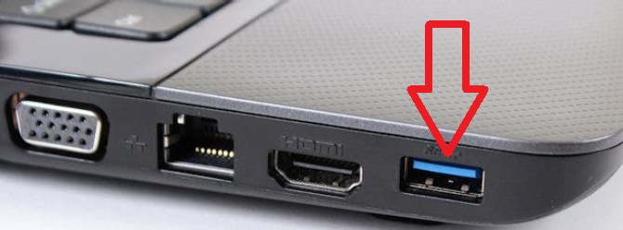
Overview of Ports in devices

Slide 11

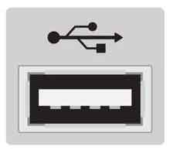
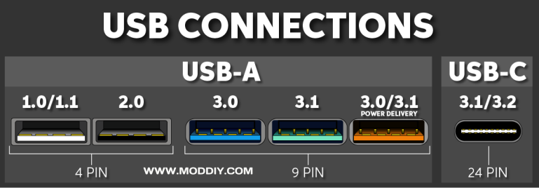
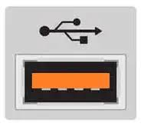
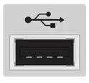
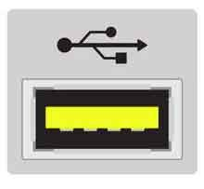
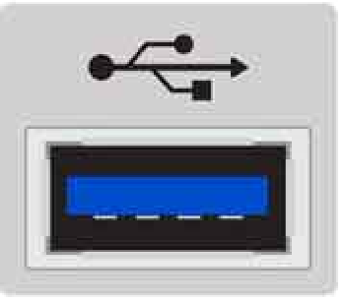
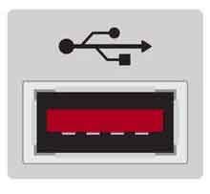
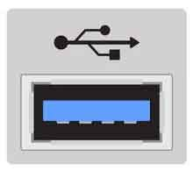
Color Coding Of USB Ports
USB 1.0
USB 2.0
Provides Charging In Sleep Mode
USB 3.0
USB 3.2
USB 3.1

Slide 12
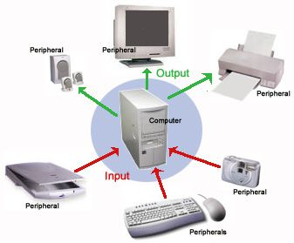
How USB Works ?
Key Features:
Hosts
Peripheral devices
Hubs
USB is controlled by hosts.
In USB we consider 7-bit addressing.

Slide 13
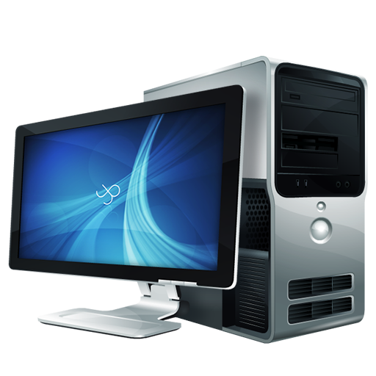

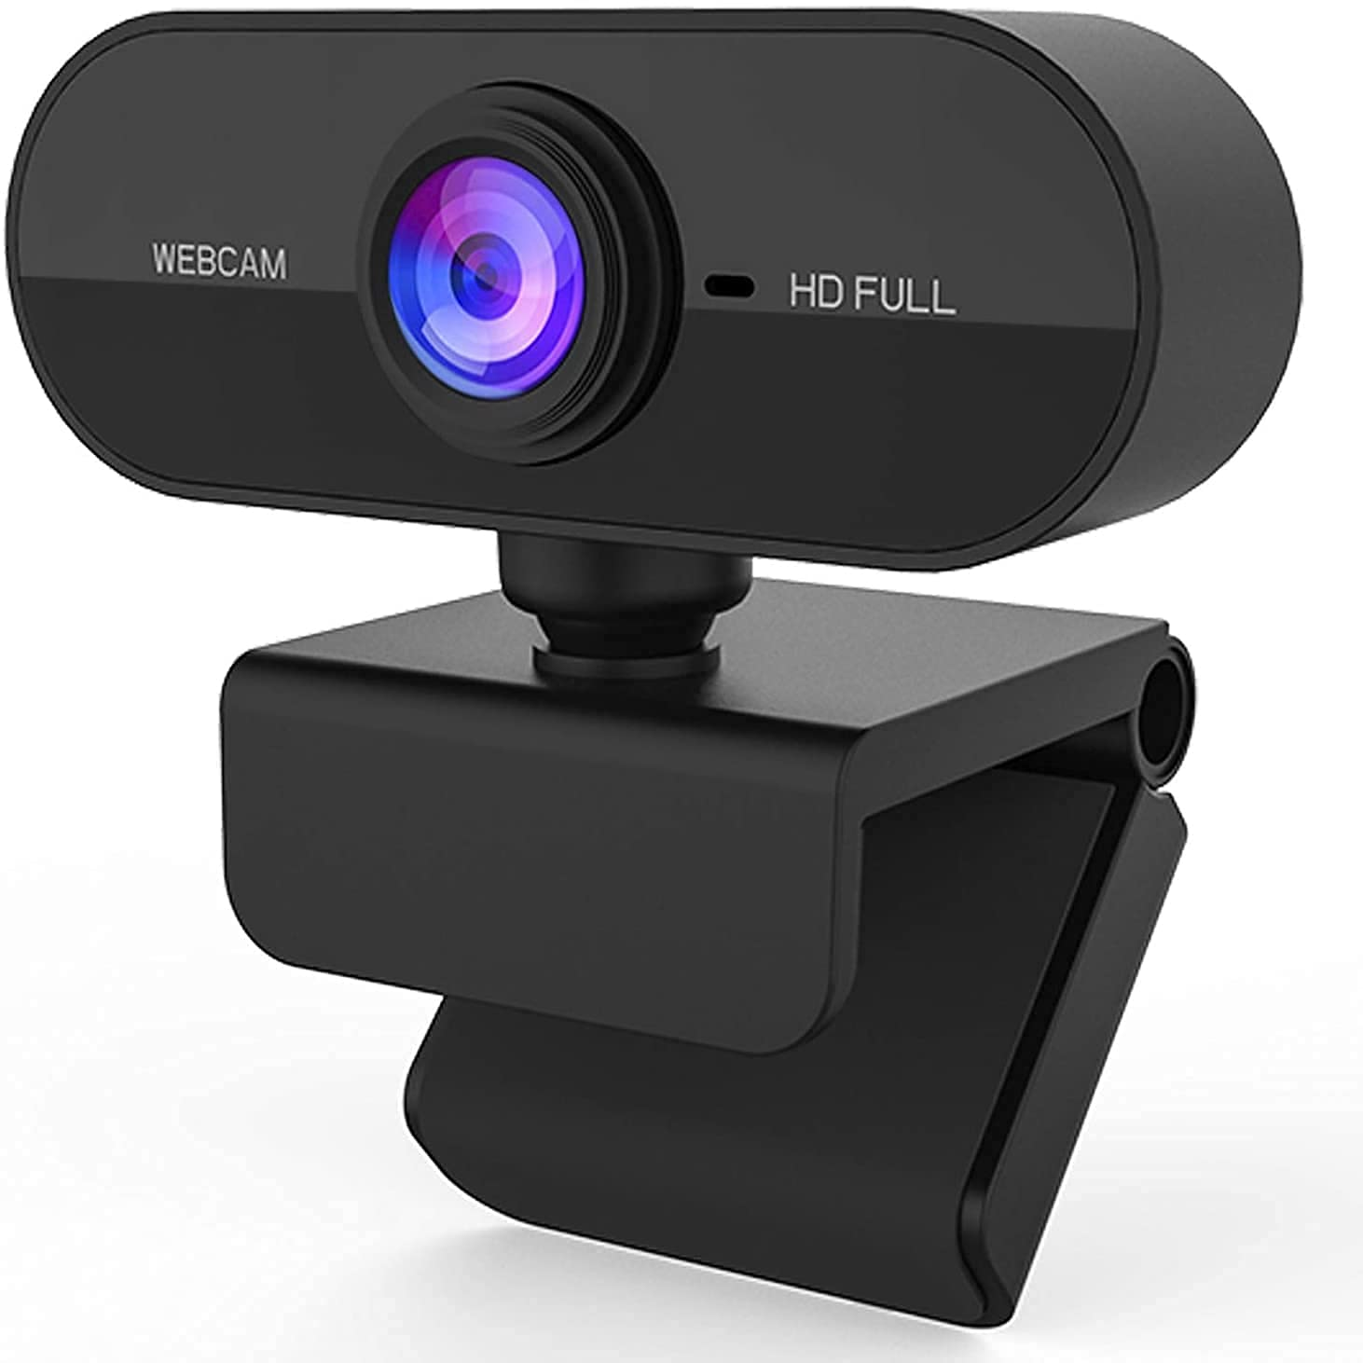
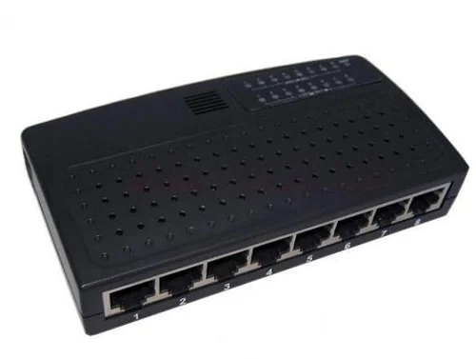
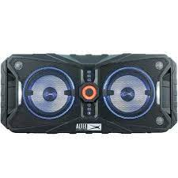
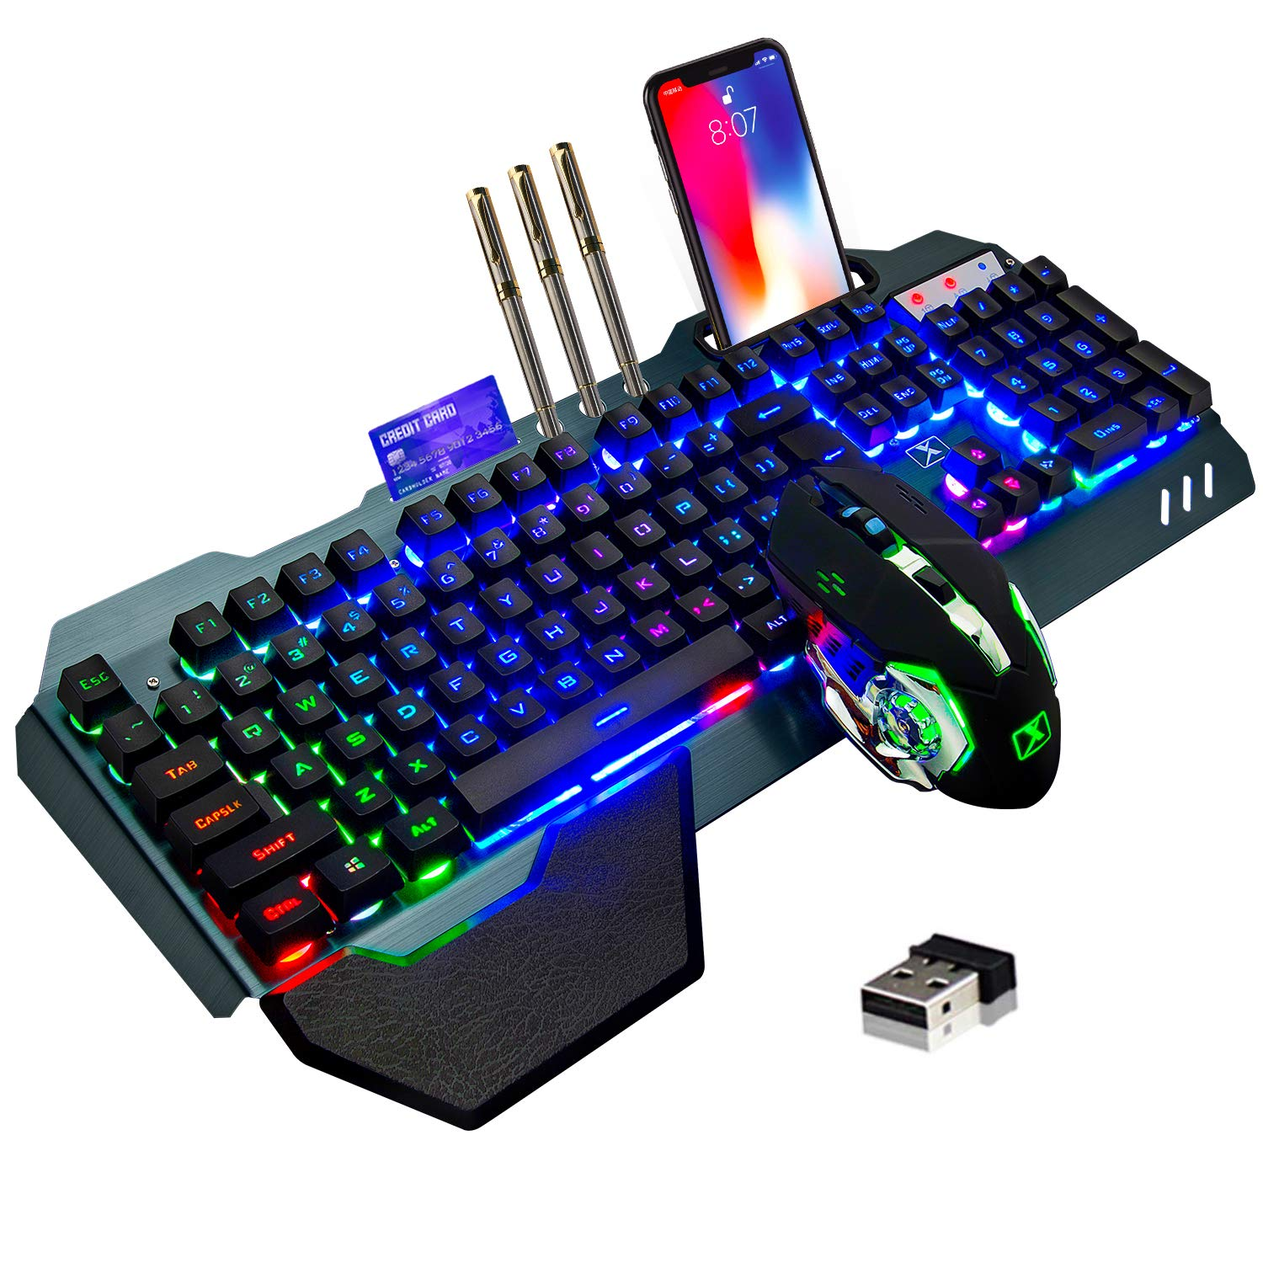
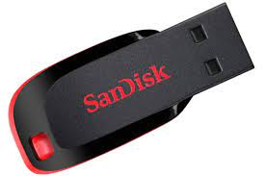
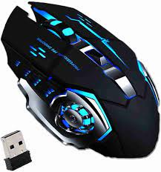
HOST
HUB

Slide 14
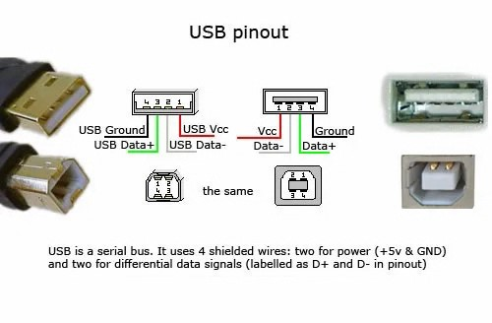
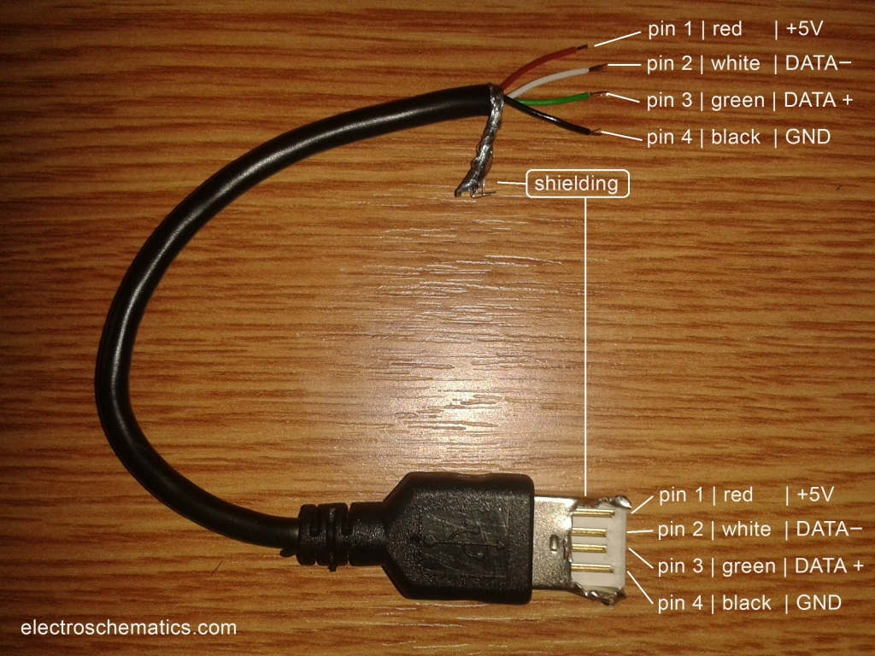
How does USB work ?

